Slide 1
Learning Objective
I will be able to determine probabilities of continuous random variables
Success Criteria
At the end of the lesson, I will be able to:
4.2.1 Use relative frequencies and histograms obtained from data to estimate probabilities associated with a continuous
random variable
4.2.2 Examine the concepts of a probability density function, cumulative distribution function, and probabilities associated with a continuous random variable given by integrals; examine simple types of continuous random variables and use them in appropriate contexts

Slide 2
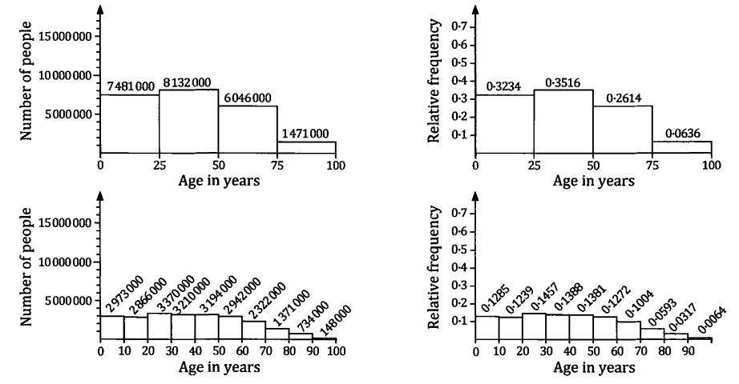
Histograms and Relative Frequencies
Graphs of histograms, are often used to represent data shown in intervals (e.g. ages under 25 years old, ages from 25 to 30 years old etc).
The probability of something occurring can be calculated from a histogram if we convert all the bars to relative frequencies.

Slide 3
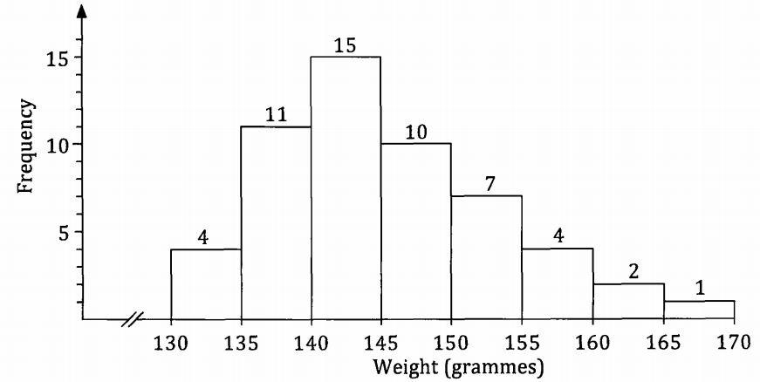
Guided Practice
A number of apples of a particular species were purchased from a supermarket. The weight of each apple was measured and noted. The distribution of weights gave rise to the following frequency histogram.
An apple of this same species is purchased from a supermarket. If the weight of this apple is W grammes, use the above data to suggest values for each of the following probabilities, giving your estimates as decimals, rounded to two decimal places.
a) P(W < 140) b) P(W ≥ 140) c) P(140 < W < 160) d) P(W < 150|W > 140)

Slide 4

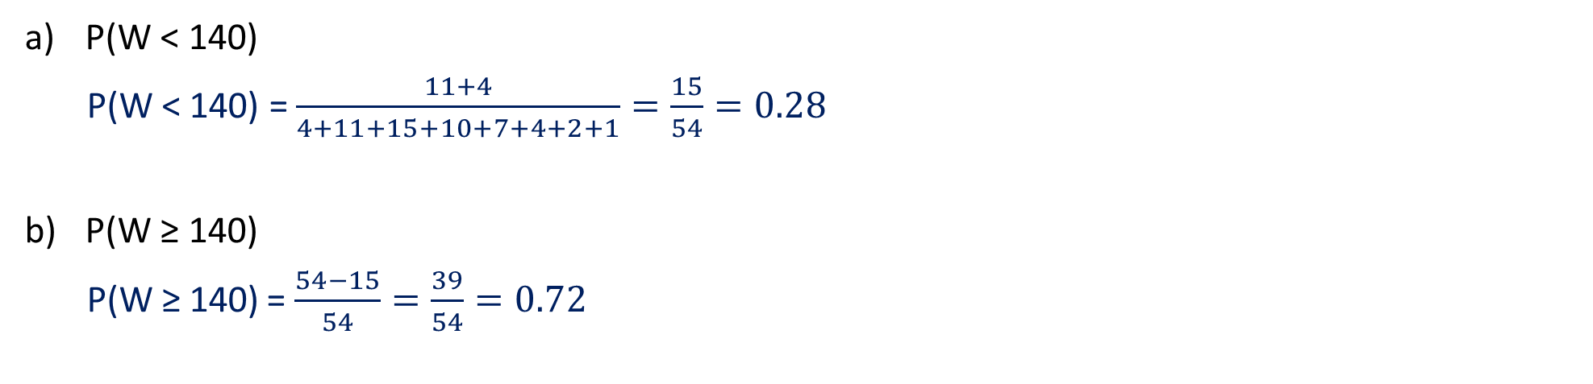
Guided Practice
P(140 < W < 160)
P(140 < W < 160) = $\frac{15+10+7+4}{54}=\frac{36}{54}=0.67$
P(W < 150|W > 140) = $\frac{P(140 < W < 150)}{P(W > 140)}=\frac{25}{39}$
= 0.64
P(W < 140)
P(W < 140) = $\frac{11+4}{4+11+15+10+7+4+2+1}=\frac{15}{54}=0.28$
P(W ≥ 140)
P(W ≥ 140) = $\frac{54−15}{54}=\frac{39}{54}=0.72$

Slide 5
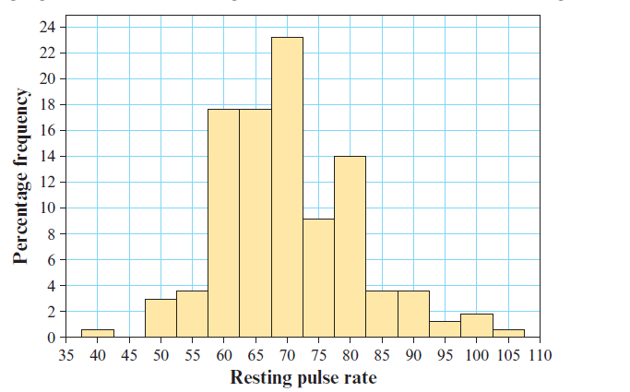


Guided Practice
Let $X$ be the resting pulse (in beats per minute) of a randomly chosen person. The following percentage frequency data was obtained from a random sample of people, with each recorded pulse rate rounded to the nearest 5 beats per minute.
Use the histogram to estimate:
a)$P(62.5≤X<67.5)$ b) $P(67.5≤X<87.5)$
$$P\left(62.5≤X<67.5\right)≈0.18$$
$$P\left(67.5≤X<87.5\right)≈0.23+0.09+0.14+0.04=0.5$$

Slide 6
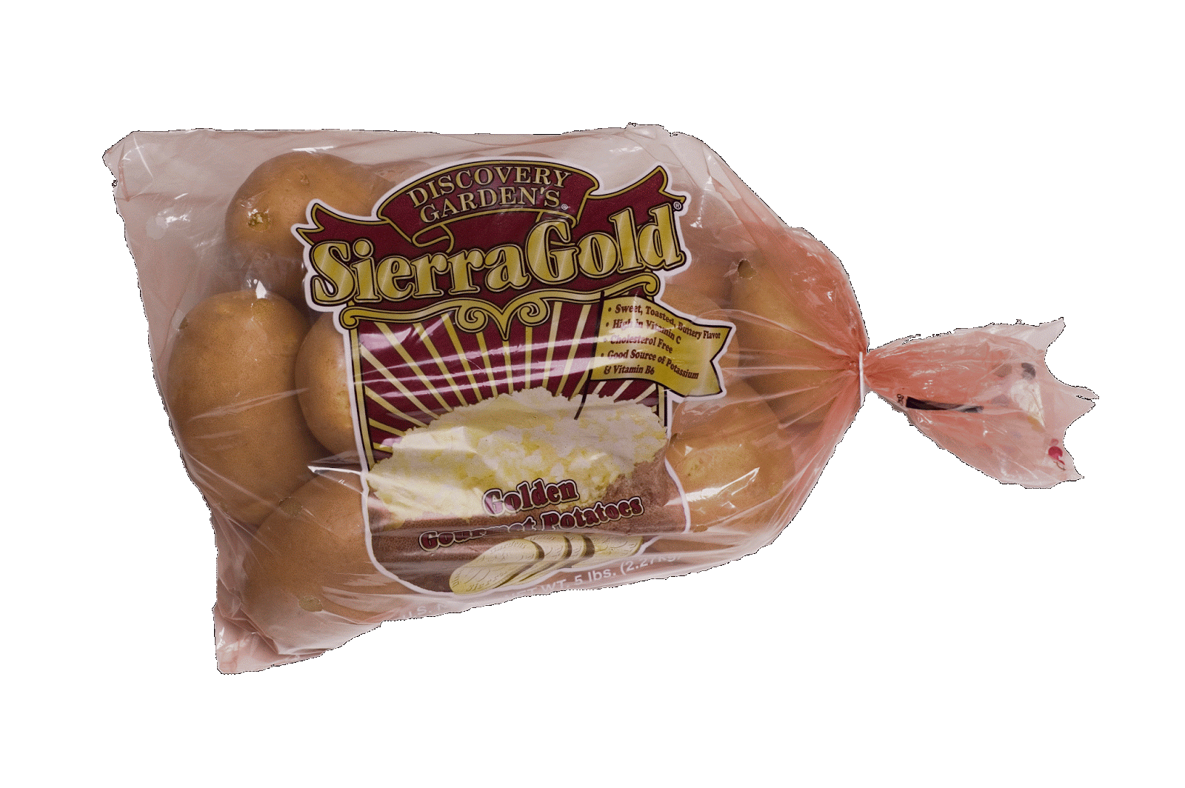
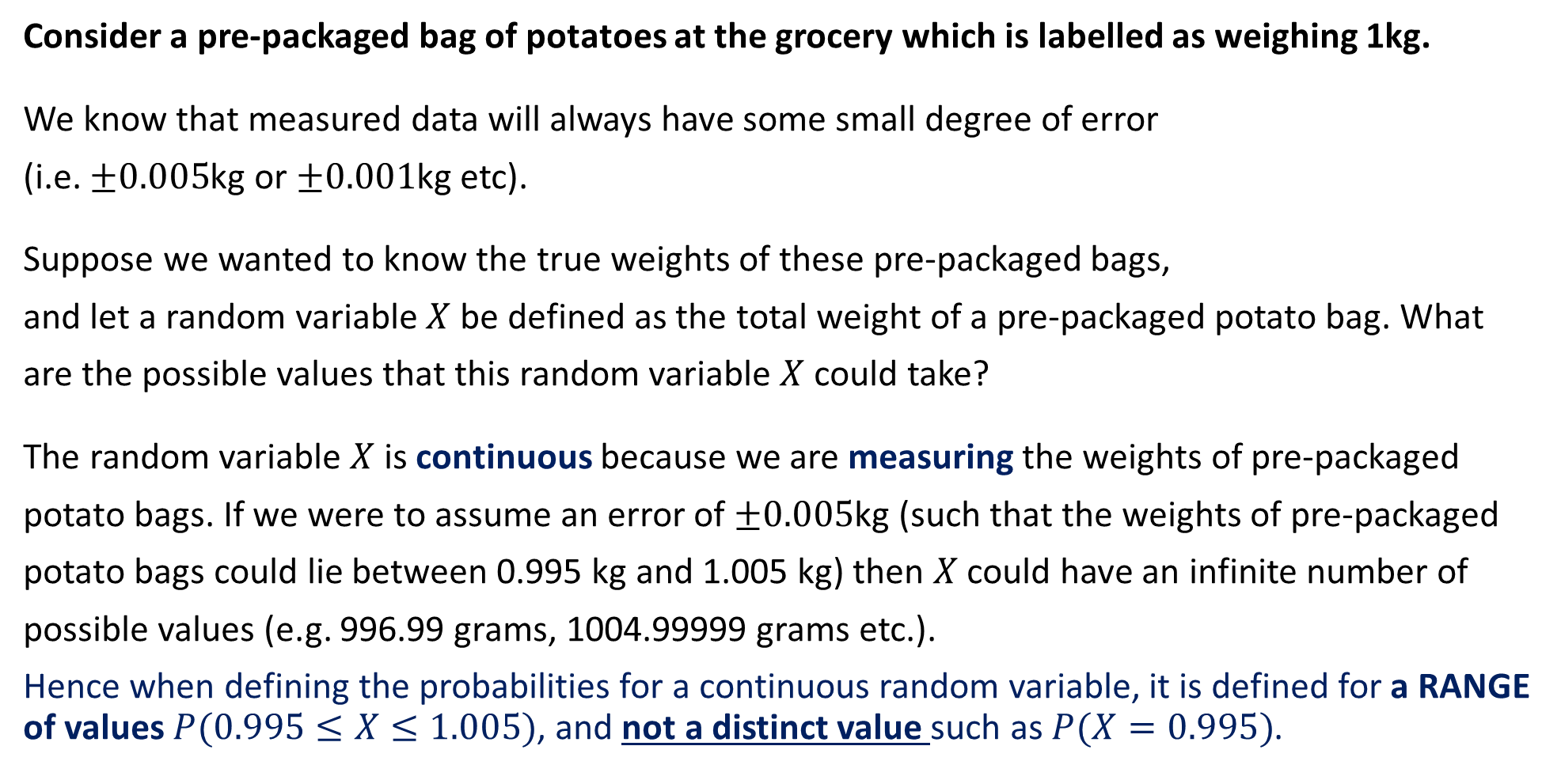
Continuous Random Variables
Consider a pre-packaged bag of potatoes at the grocery which is labelled as weighing 1kg.
We know that measured data will always have some small degree of error
(i.e. $±0.005$kg or $±0.001$kg etc).
Suppose we wanted to know the true weights of these pre-packaged bags,
and let a random variable $X$be defined as the total weight of a pre-packaged potato bag. What
are the possible values that this random variable$X$could take?
The random variable $X$ is continuous because we are measuring the weights of pre-packaged
potato bags. If we were to assume an error of $±0.005$kg (such that the weights of pre-packaged
potato bags could lie between 0.995 kg and 1.005 kg) then $X$ could have an infinite number of
possible values (e.g. 996.99 grams, 1004.99999 grams etc.).
Hence when defining the probabilities for a continuous random variable, it is defined for a RANGE of values $P(0.995≤X≤1.005)$, and not a distinct value such as $P(X=0.995)$.

Slide 7
DISCRETE RANDOM VARIABLES (DRV) | CONTINUOUS RANDOM VARIABLES (CRV)
Refers to events where the variables have been counted (e.g. number of students attending school) | Refers to events where the variables have been measured (e.g. heights and weights of students)
Usually uses whole values (counting numbers) but most notably, data is represented by distinct values because the data has been COUNTED. | Always inclusive of decimal values and often uses class intervals to represent a range of values for the variables (because there are infinitely many number of values that the variable can take)
Distributions using DRVs include Bernoulli distributions, Binomial distributions and Uniform distributions | Distributions using CRVs include Normal, Exponential and Uniform distributions.
Probability calculations involve the use of counting techniques | Probability calculations involve the use of integration to find the area under the curve of the PDF
When using inequalities (e.g. P(0 ≤ X < 5)) the values of X in a DRV only count discrete values. In the above example, the values counted between 0 and 5 be 4, 3, 2, 1, 0. | When using inequalities (e.g. P(0 ≤ X < 5)) the values of X in a CRV will count all possible values between 0 and 5 including 0. In the above example, the values measured would include 4.9, 3.8, 0.1, 4.9999, 0.00001, 2 etc.

Slide 8
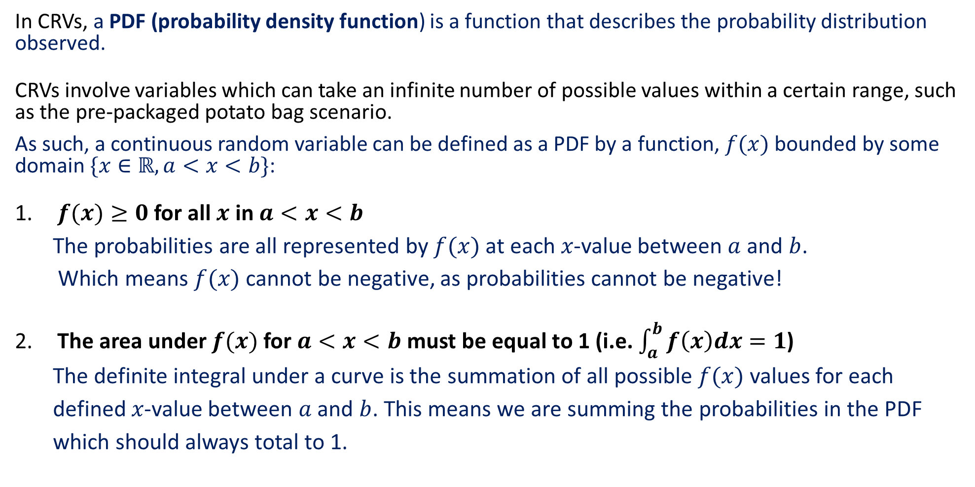
PDF (Probability Density Functions)
In CRVs, a PDF (probability density function) is a function that describes the probability distribution observed.
CRVs involve variables which can take an infinite number of possible values within a certain range, such as the pre-packaged potato bag scenario.
As such, a continuous random variable can be defined as a PDF by a function, $f(x)$ bounded by some domain $\{x∈ℝ, a<x<b\}$:
$f(x)≥0$ for all $x$ in $a<x<b$
The probabilities are all represented by $f(x)$ at each 𝑥-value between $a$ and $b$.
Which means $f(x)$ cannot be negative, as probabilities cannot be negative!
The area under $f(x)$ for $a<x<b$ must be equal to 1 (i.e. $\int_{a}^{b}{f\left(x\right)dx=1}$)
The definite integral under a curve is the summation of all possible $f(x)$ values for each
defined 𝑥-value between $a$ and $b$. This means we are summing the probabilities in the PDF
which should always total to 1.

Slide 9
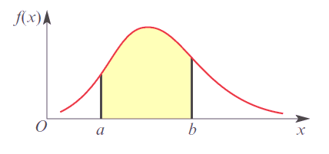

PDF (Probability Density Functions)
Consider a continuous random variable defined as a PDF by a function, $f(x)$ with some domain $\left\{x∈ℝ, −∞<x<∞\right\},$ similarly the following properties apply: a) $f\left(x\right)≥0$, for all $x$
b) $\int_{−∞}^{∞}{f\left(x\right)dx=1}$
c) $P\left(a<x<b\right)=\int_{a}^{b}{f\left(x\right)dx}, a<b$

Slide 10
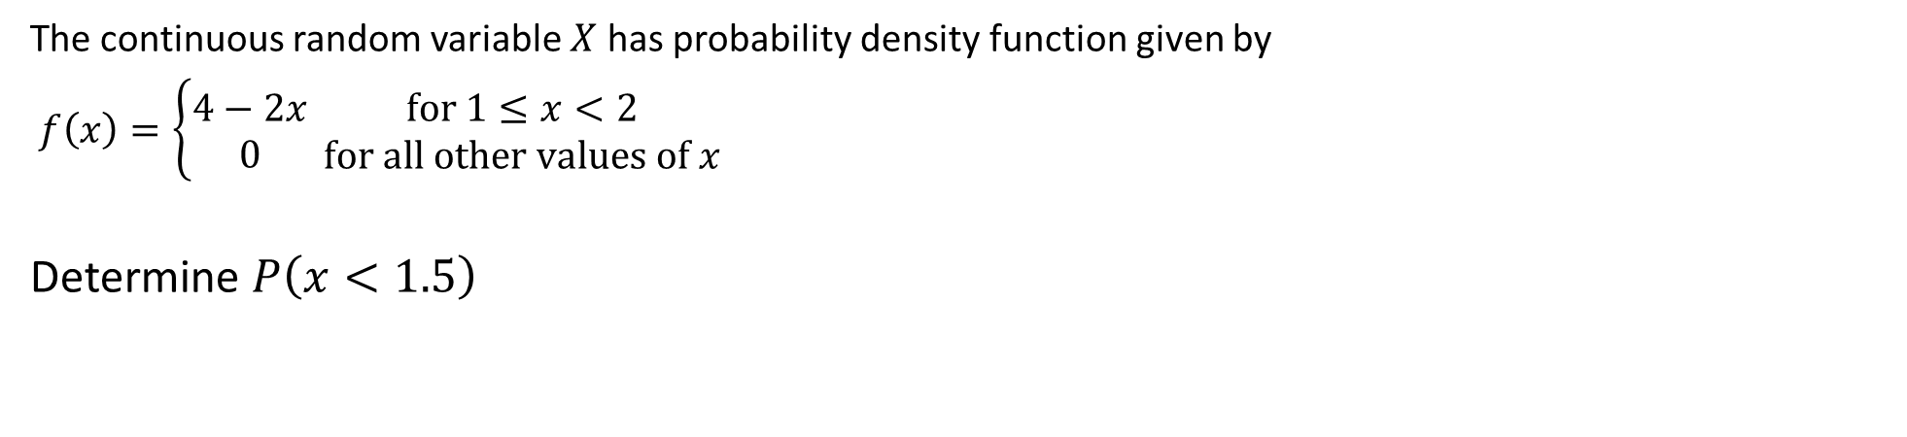

Guided Practice
The continuous random variable $X$ has probability density function given by
$f\left(x\right)=\left\{\begin{aligned}4−2x \\ 0\end{aligned}\right. \begin{matrix}for 1≤x<2 \\ for all other values of x\end{matrix}$
Determine $P\left(x<1.5\right)$
P(X <1.5) = $\int_{1}^{1.5}{4−2x dx}$
=$[4x−x^{2}]\begin{matrix}1.5 \\ 1\end{matrix}$
= $(6−2.25)−\left(4−1\right)$
= 0.75

Slide 11
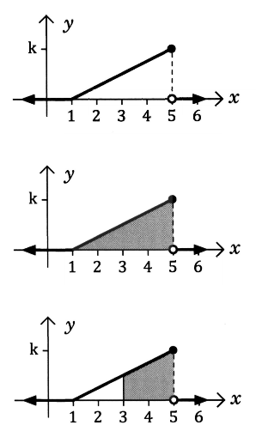
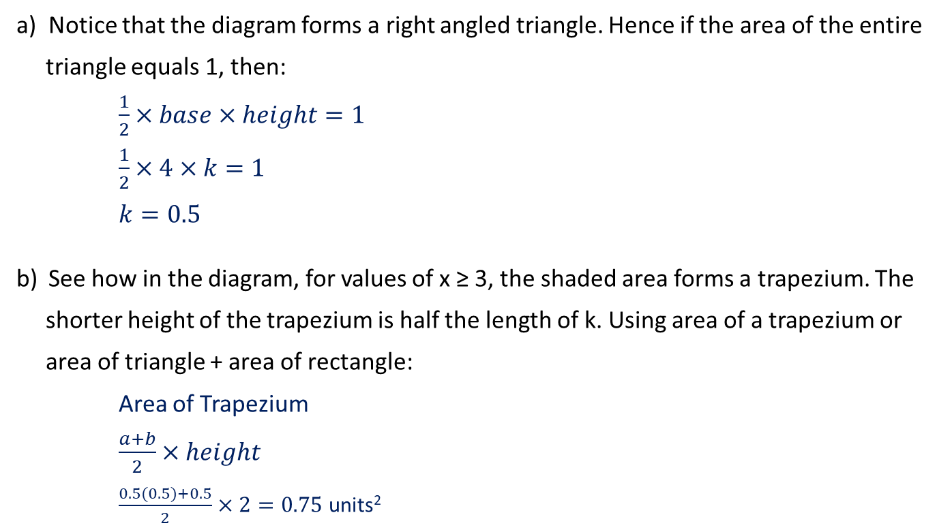
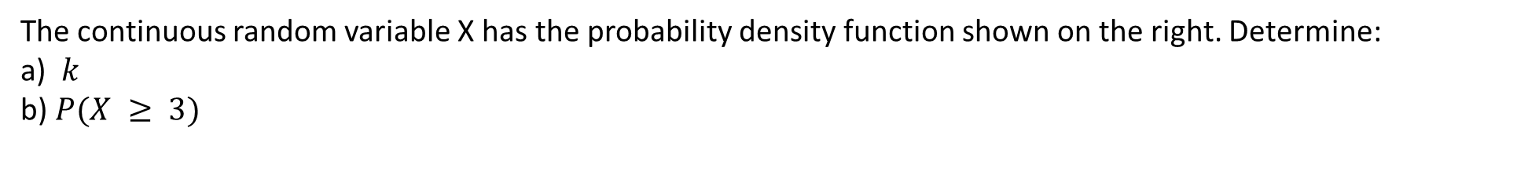
Guided Practice
The continuous random variable X has the probability density function shown on the right. Determine:
a) $k$
b) $P(X ≥ 3)$
Notice that the diagram forms a right angled triangle. Hence if the area of the entire
triangle equals 1, then:
$\frac{1}{2}×base×height=1$
$\frac{1}{2}×4×k=1$
$k=0.5$
See how in the diagram, for values of x ≥ 3, the shaded area forms a trapezium. The
shorter height of the trapezium is half the length of k. Using area of a trapezium or
area of triangle + area of rectangle:
Area of Trapezium
$\frac{a+b}{2}×height$
$\frac{0.5(0.5)+0.5}{2}×2=0.75$ units²

Slide 12
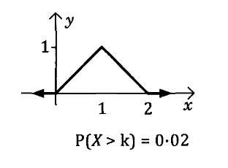
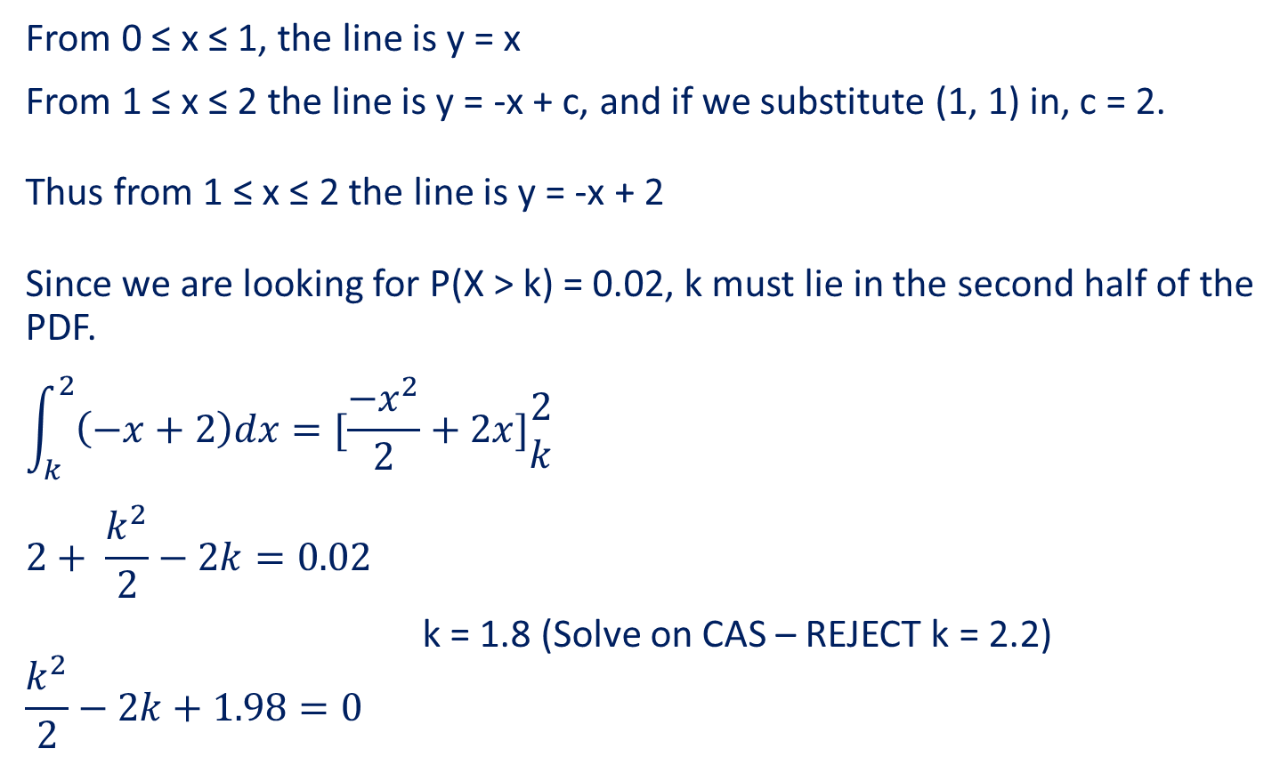
Guided Practice
Given that the graph shows the probability density function y = f(x), determine the value of k.
From 0 ≤ x ≤ 1, the line is y = x
From 1 ≤ x ≤ 2 the line is y = -x + c, and if we substitute (1, 1) in, c = 2.
Thus from 1 ≤ x ≤ 2 the line is y = -x + 2
Since we are looking for P(X > k) = 0.02, k must lie in the second half of the PDF.
$$\int_{k}^{2}{\left(−x+2\right)dx}=[\frac{−x^{2}}{2}+2x]\begin{matrix}2 \\ k\end{matrix}$$
$$2+ \frac{k^{2}}{2}−2k=0.02$$
k = 1.8 (Solve on CAS – REJECT k = 2.2)
$$\frac{k^{2}}{2}−2k+1.98=0$$

Slide 13
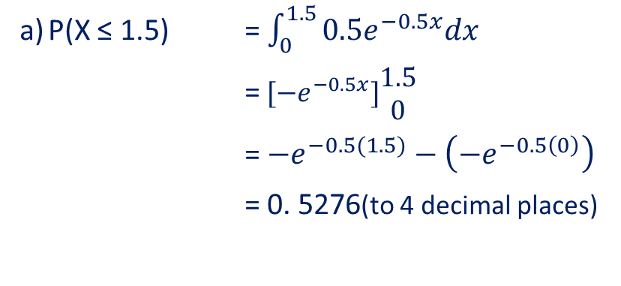
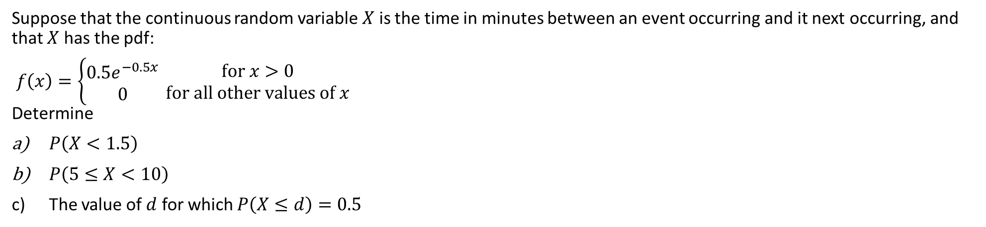
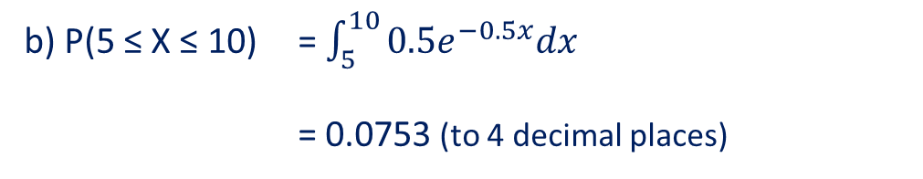
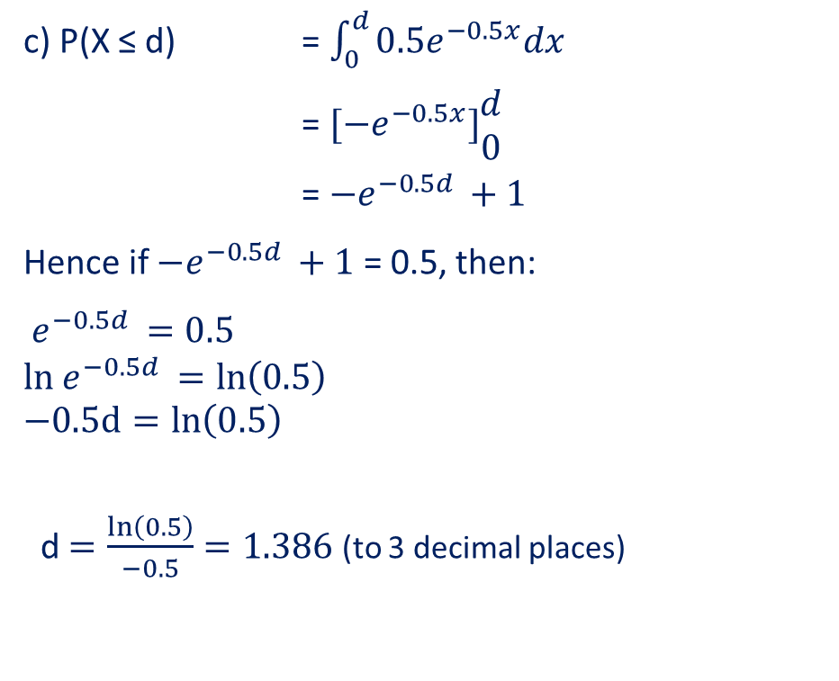
Guided Practice
Suppose that the continuous random variable $X$ is the time in minutes between an event occurring and it next occurring, and that $X$ has the pdf:
$f\left(x\right)=\left\{\begin{aligned}0.5e^{−0.5x} \\ 0\end{aligned}\right. \begin{matrix}for x>0 \\ for all other values of x\end{matrix}$ Determine
$P\left(X<1.5\right)$
$P\left(5≤X<10\right)$
The value of $d$ for which $P\left(X≤d\right)=0.5$
c) P(X ≤ d) = $\int_{0}^{d}{0.5e^{−0.5x}dx}$
= $[{−e}^{−0.5x}]\begin{matrix}d \\ 0\end{matrix}$
= ${−e}^{−0.5d }+1$
Hence if ${−e}^{−0.5d }+1$ = 0.5, then:
$e^{−0.5d }=0.5$
$$ln{ e}^{−0.5d }=\ln\left(0.5\right)$$
$$−0.5d=ln\left(0.5\right)$$
d $=\frac{ln\left(0.5\right)}{−0.5}=1.386$ (to 3 decimal places)
P(X ≤ 1.5) = $\int_{0}^{1.5}{0.5e^{−0.5x}dx}$
=$[{−e}^{−0.5x}]\begin{matrix}1.5 \\ 0\end{matrix}$
= ${−e}^{−0.5(1.5)}−\left({−e}^{−0.5\left(0\right)}\right)$
= 0. 5276(to 4 decimal places)
P(5 ≤ X ≤ 10) = $\int_{5}^{10}{0.5e^{−0.5x}dx}$
= 0.0753 (to 4 decimal places)

Slide 14
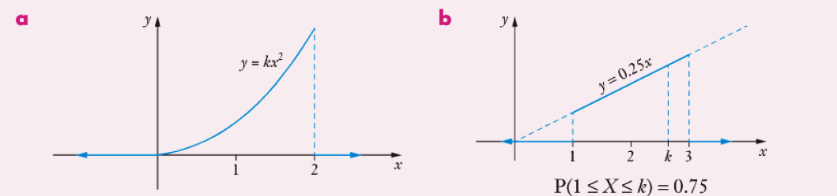







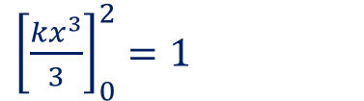
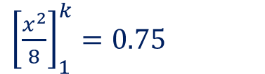

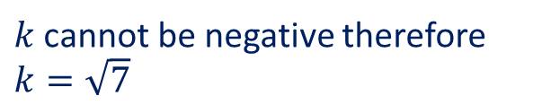
Guided Practice
Each of the diagrams below show probability denisity functions. Use calculus to determine the value of $k$ in each case.
$\int_{0}^{2}{kx^{2} dx}=1$
$\int_{1}^{k}{0.25x dx}=0.75$
${\left[\frac{kx^{3}}{3}\right]}_{0}^{2}=1$
${\left[\frac{x^{2}}{8}\right]}_{1}^{k}=0.75$
$\frac{k{\left(2\right)}^{3}}{3}−0=1$
$\frac{k^{2}}{8}−\frac{1}{8}=0.75$
$\frac{8k}{3}=1$
$k^{2}=7$
$$k=\frac{3}{8}$$
$k=±\sqrt{7}$
$k$ cannot be negative therefore $k=\sqrt{7}$

Slide 15

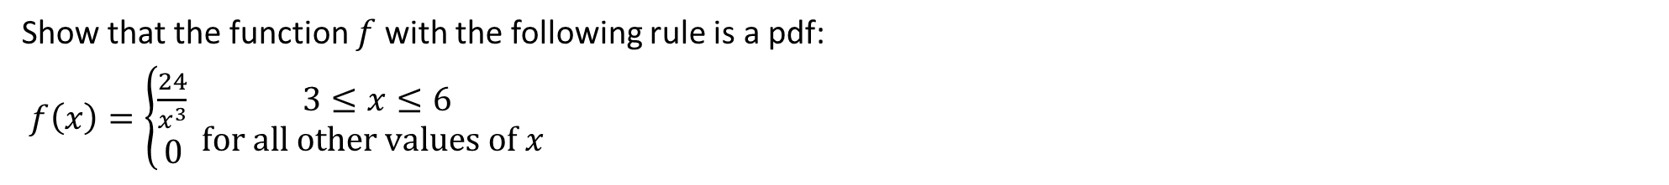
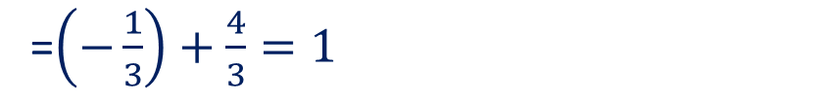
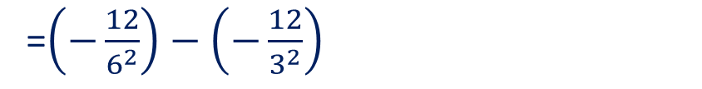
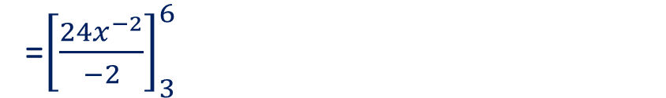
Guided Practice
Show that the function $f$ with the following rule is a pdf:
$f\left(x\right)=\left\{\begin{aligned}\frac{24}{x^{3}} \\ 0\end{aligned}\right. \begin{matrix} 3≤x≤6 \\ for all other values of x\end{matrix}$
$\int_{3}^{6}{\frac{24}{x^{3}} dx}=\int_{3}^{6}{24x^{−3} dx}$
=${\left[\frac{24x^{−2}}{−2}\right]}_{3}^{6}$
=$\left(−\frac{12}{6^{2}}\right)−\left(−\frac{12}{3^{2}}\right)$
=$\left(−\frac{1}{3}\right)+\frac{4}{3}=1$

Slide 16



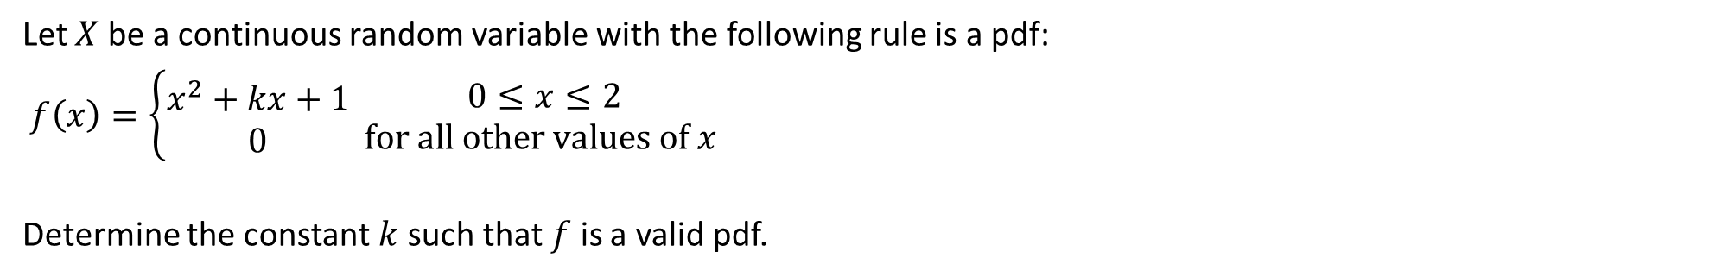


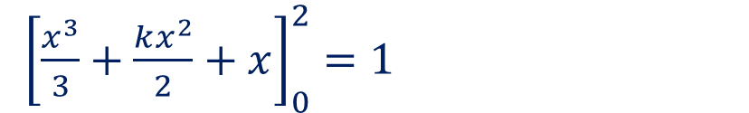
Guided Practice
Let $X$ be a continuous random variable with the following rule is a pdf:
$f\left(x\right)=\left\{\begin{aligned}x^{2}+kx+1 \\ 0\end{aligned}\right. \begin{matrix} 0≤x≤2 \\ for all other values of x\end{matrix}$
Determine the constant $k$ such that $f$ is a valid pdf.
$\int_{0}^{2}{x^{2}+kx+1 dx}=1$
${\left[\frac{x^{3}}{3}+\frac{kx^{2}}{2}+x\right]}_{0}^{2}=1$
$\frac{8}{3}+\frac{4k}{2}+2=1$
$2k=1−2−\frac{8}{3}$
$2k=−\frac{11}{3}$
$k=−\frac{11}{6}$

Slide 17

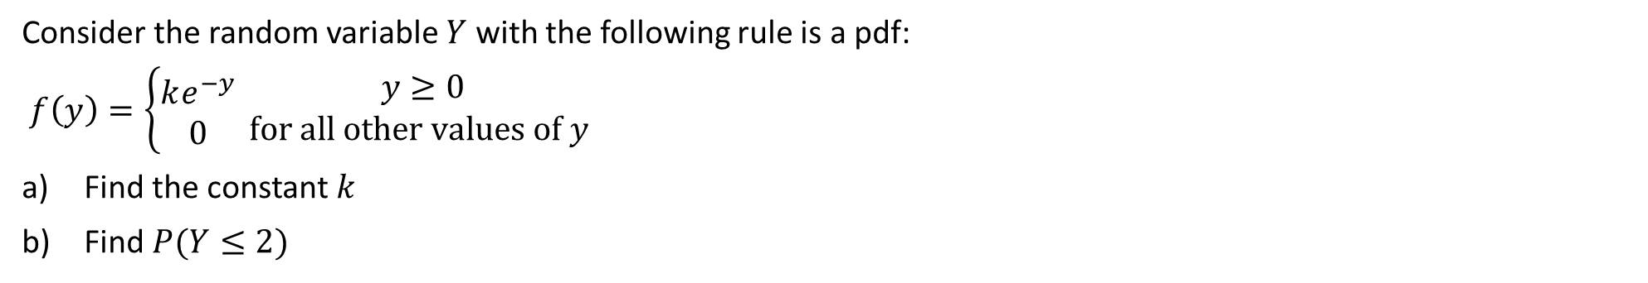

Guided Practice
Consider the random variable $Y$ with the following rule is a pdf:
$f\left(y\right)=\left\{\begin{aligned}ke^{−y} \\ 0\end{aligned}\right. \begin{matrix} y≥0 \\ for all other values of y\end{matrix}$
Find the constant $k$
Find $P(Y≤2)$
$\int_{0}^{∞}{ke^{−y}dy}=1$
$P\left(Y≤2\right)=\int_{0}^{2}{e^{−y}dy}$
${\left[−ke^{−y}\right]}_{0}^{∞}=1$
${=\left[−e^{−y}\right]}_{0}^{2}$
$−ke^{−∞}+k=1$
$=−e^{−2}+1≈0.865 (3d.p.)$
$−ke^{−∞}→0, ∴k=1$

Slide 18
Independent Practice
Complete Ex 10A + Worksheet

